Slide 1
Concept of the DarkNet
What is the DarkNet?

Slide 2
Table of contents
Presentation
Useful examples : advantages
Disadvantages
My experience and opinion

Slide 3
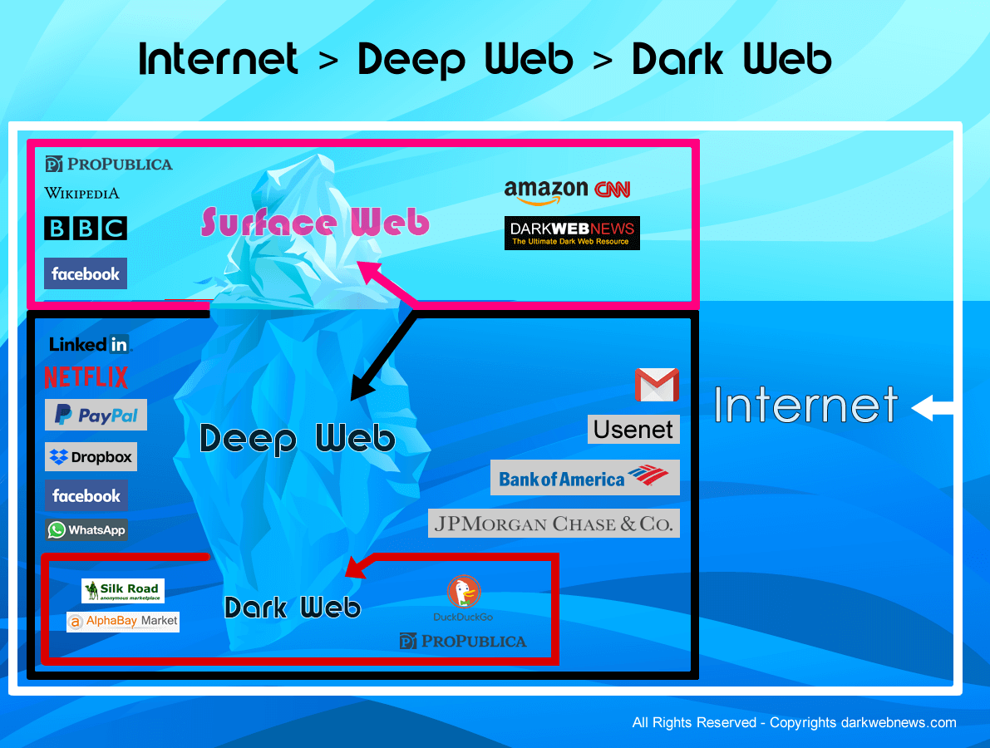
Presentation
Layer of internet not open to public views Originally described computers on ARPANET Url with .onion

Slide 4

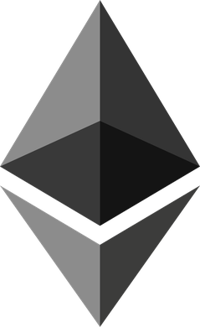
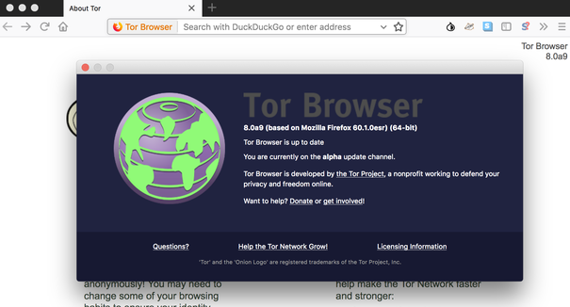
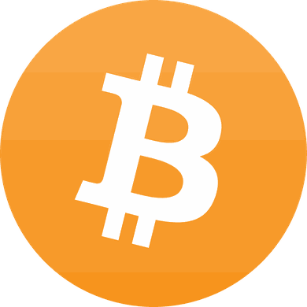
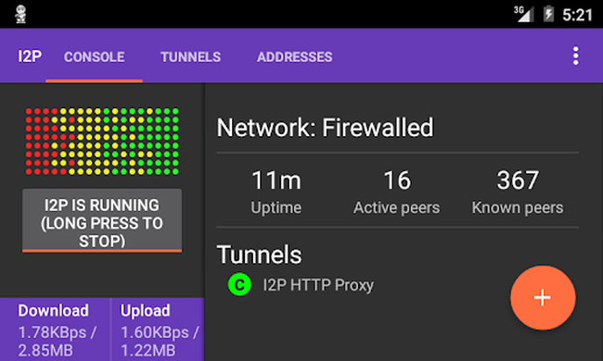
Needs
Computer / mobile phone = internet connection
Bitcoin wallet
Cryptocurrency like bitcoin, monero , etherum TOR (the onion touter) or I2P (invisible internet project) cloack you and anonymazing

Slide 5
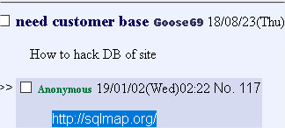
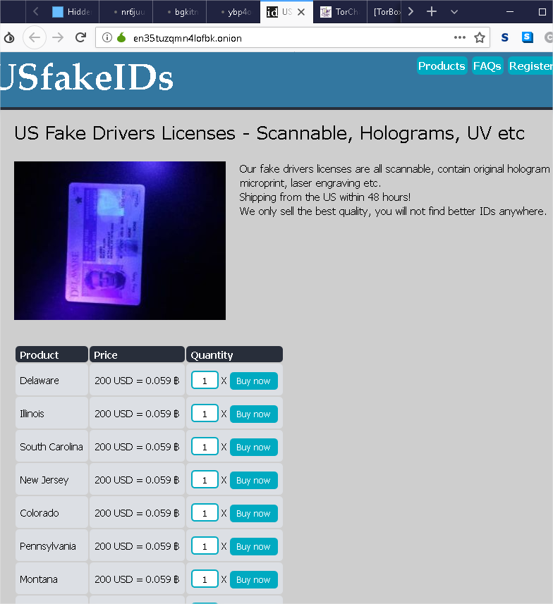
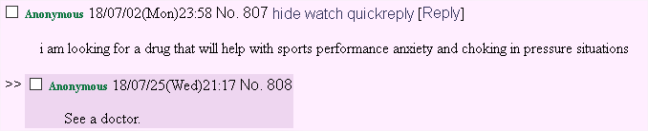
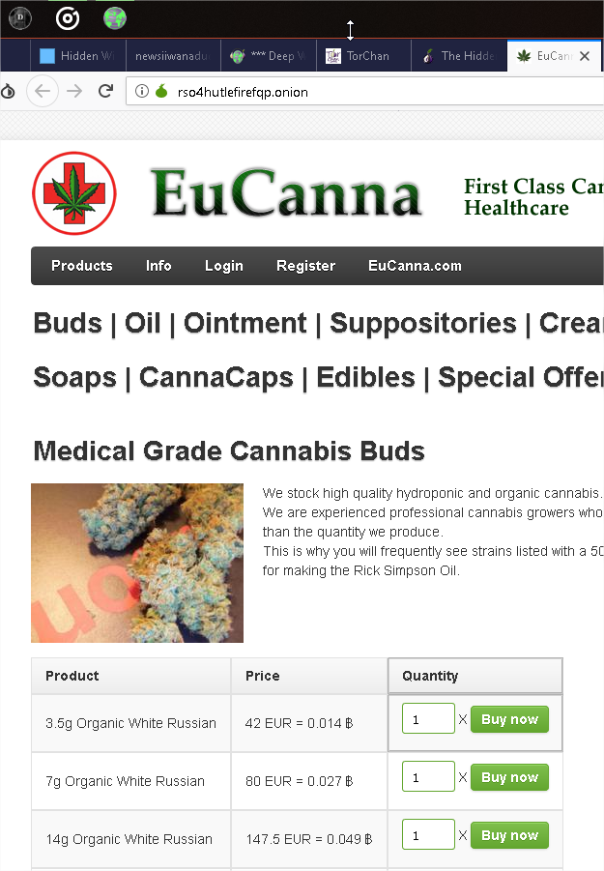
Disadvantages
Contraband
Illegal services
Storing money in online wallets
Risk : caught with smuggle, get prosecution
Customers can never be sure that the stuff they order is the stuff they will get
Shipment seizing
you can never check the quality of the product

Slide 6
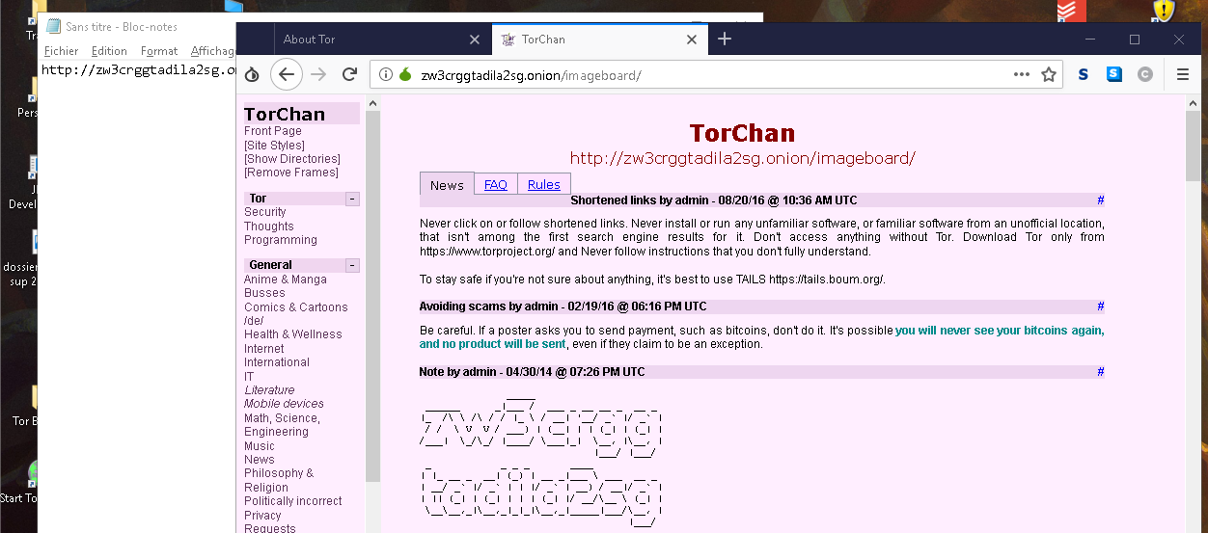

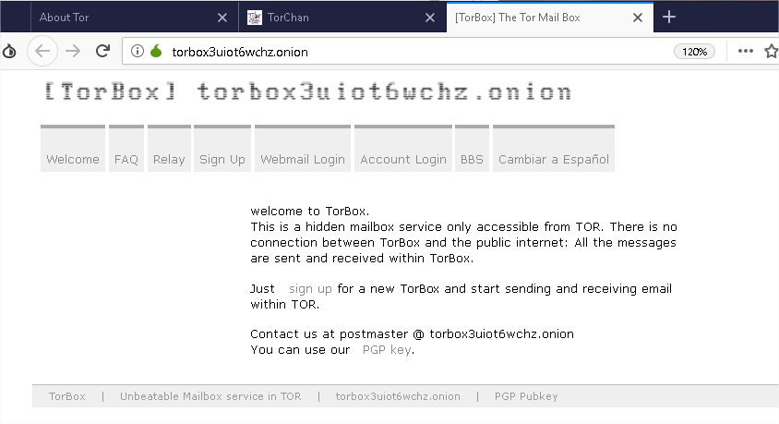
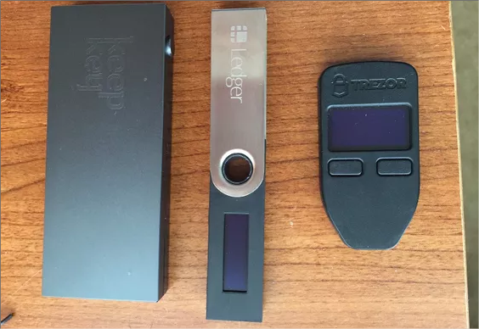
Advantages
Anonymity
No physical contact
You can buy many products that are not available in your country
Convenience for shipping
Hardware wallet created

Slide 7
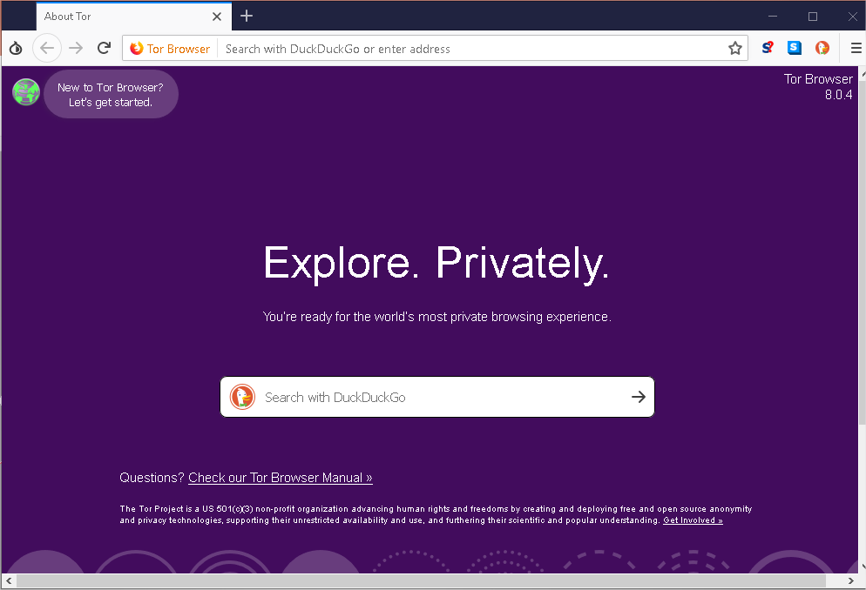
Conclusion
Liberty expression
Illegal products
My experience and opinion

